Slide 1
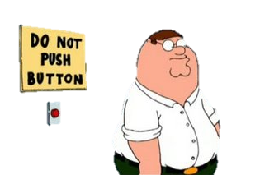
Plagiarism (how to not do it)

Slide 2
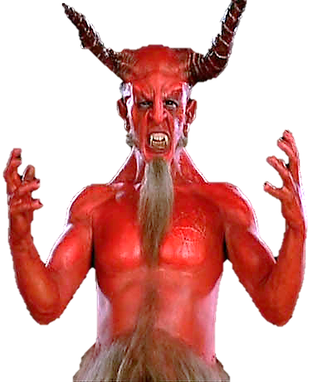
Plagiarism (why people do it)
Don’t know what it is
Don’t consider it wrong
Path of least resistance
Procrastination and pressure
Personal academic insecurities
The thrill of evil

Slide 3
Plagiarism (Consequences in college)
Failure of the course
No refund for the class
Revocation of scholarships
Cancellation of student loans
Possible expulsion
Wrath of the professor

Slide 4
Plagiarism (Consequences in AP Lit)
Failure of the six weeks
Clean re-do of the paper
Referral to administrator
Removal from honor societies
Possible retroactive deferment
Removal of my faith in humanity

Slide 5
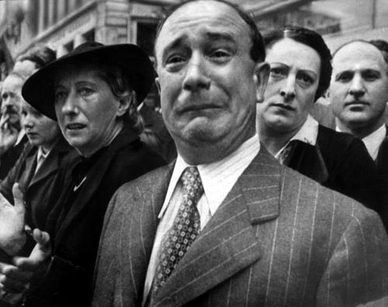
ME →

Slide 6
Plagiarism (why it’s seductive)

Slide 7
Plagiarism (why it’s seductive)
You are asked to …
Develop a topic based on what has already been said and written …
But also write something new and original.

Slide 8
Plagiarism (why it’s seductive)
You are asked to …
Rely on experts’ and authorities’ opinions …
But also improve upon and/or disagree with those same opinions.

Slide 9
Plagiarism (why it’s seductive)
You are asked to …
Give credit to previous writers and researchers …
But also make your own significant contribution.

Slide 10
Plagiarism (why it’s seductive)
You are asked to …
Improve your English to fit into an academic community by building on what you hear and read …
But also use your own voice.

Slide 11
Plagiarism (what it is)

Slide 12
Plagiarism (what it is)
the uncredited (deliberate or accidental) use of somebody else’s words or ideas

Slide 13
Plagiarism (what it is)
There are two types:
Deliberate plagiarism

Slide 14
Plagiarism (what it is)
There are two types:
Deliberate plagiarism … such as buying, stealing, borrowing, or hiring out a paper or copying large sections of text without proper citation

Slide 15
Plagiarism (what it is)
… and Accidental plagiarism

Slide 16
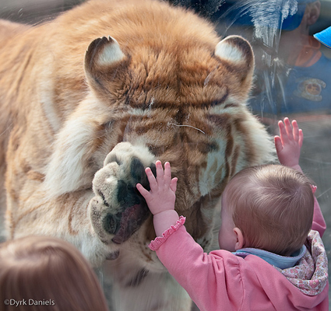
PLAGIARISM
YOU

Slide 17
Plagiarism (what it is)
Accidental plagiarism
springs from a lack of knowledge about how to cite, how to paraphrase, how to summarize, and how to use quotations.

Slide 18
Plagiarism (what it is)
Copying directly*
Copying with rearrangement*
Copying with selected omissions*
Copying distinctive phrases*
Paraphrasing*
* without proper citation

Slide 19
Plagiarism (what it is)
Stating (not common knowledge) facts*
Secondary citation*
Summarizing*
Unclear or misleading citations
Citing fake or unfindable sources
* without proper citation

Slide 20
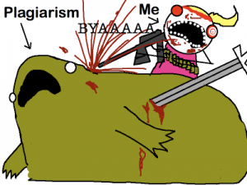
Plagiarism (How to not do it)

Slide 21
Plagiarism (How to not do it)
Cite every piece of information that is not:
common knowledge (including opinions, argument, speculations, facts, details, figures, and statistics)
the result of your own personal analysis

Slide 22
Plagiarism (How to not do it)
There are three ways to use a source.

Slide 23
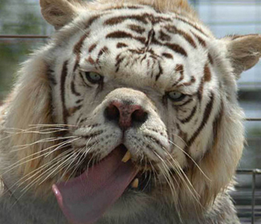
WHAT ARE THEY?!!?1

Slide 24
Plagiarism (How to not do it)
Direct quotation
Paraphrase
Summary

Slide 25
K. THANKS! BYE.

Slide 26
Plagiarism (How to not do it)
When using direct quotes, use quotation marks and proper citation every time you use someone else’s words, using brackets [ ] to give context to a quote or otherwise alter it.

Slide 27
Plagiarism (How to not do it)
A paraphrase must contain all of the author’s information and none of your own commentary or elaboration; a corrupted paraphrase is plagiarism.

Slide 28
Plagiarism (How to not do it)
A paraphrase should always restate all the main points of the source in the same order and in about the same number of words.

Slide 29
Plagiarism (How to not do it)
A paraphrase cannot use the author’s own words, phrasing, or sentence structure
A corrupted paraphrase is plagiarism.

Slide 30
Plagiarism (How to not do it)
A paraphrase must include a parenthetical citation at the end of the last sentence of the paraphrase; an uncited paraphrase is plagiarism.

Slide 31
Plagiarism (How to not do it)
A summary of a source is much shorter than a paraphrase and must be in your own words, phrasing, and writing style.

Slide 32
Plagiarism (How to not do it)
A summary, just like a paraphrase, cannot include any of your own analysis, elaboration, or commentary.
A corrupted summary is plagiarism.

Slide 33
Plagiarism (How to not do it)
A summary must be cited, just like a quotation or paraphrase, with the parenthetical citation at the end of the last sentence of the summary of that source.

Slide 34
Plagiarism (How to not do it)
Some useful tips:
Whenever summarizing or paraphrasing, try writing without looking at the original (instead relying on memory and notes).

Slide 35
Plagiarism (How to not do it)
Then check your writing against the original text; correct any errors in content/ accuracy and sentence/ paragraph structure.

Slide 36
Plagiarism (How to not do it)
Within a paraphrase or summary – you may include direct quotes, placing quotation marks around any distinct words or phrases that you cannot or do not want to change.

Slide 37
Plagiarism (How to not do it)
At the beginning of the first sentence in which you quote, paraphrase, or summarize make it clear that what comes next is someone else’s idea:
Ex. According to Smith …

Slide 38
Plagiarism (How to not do it)
Ex. According to Smith …
Brown claims …
In “Essay,” Wu asks …

Slide 39
Plagiarism (How to not do it)
At the end of the last sentence containing quoted, paraphrased, or summarized material, insert a parenthetical citation to properly cite the material.

Slide 40
Plagiarism (How to not do it)
Any quoted, paraphrased, or summarized material that comes after the reference is plagiarized: it looks like it is supposed to be your own idea.

Slide 41
Plagiarism (How to not do it)
All facts must be cited …
Except for information that can be considered “common knowledge” (if you can find it undocumented in at least five credible sources)

Slide 42
Plagiarism (How to not do it)
Secondary citation is
another big no-no:
Let’s say you’re reading Smith, and Smith cites Brown. You really like what Brown said, but you don’t have access to it ...

Slide 43
Plagiarism (How to not do it)
Unless you can find the Brown text on your own, you cannot use that information.
Secondary citation would be using the Brown information and citing it as Smith.

Slide 44
Plagiarism (in summary)
Every sentence of your paper falls into one of 4 categories:
Cited paraphrase
Cited summary
Cited quotation
Your own personal idea

