Slide 1
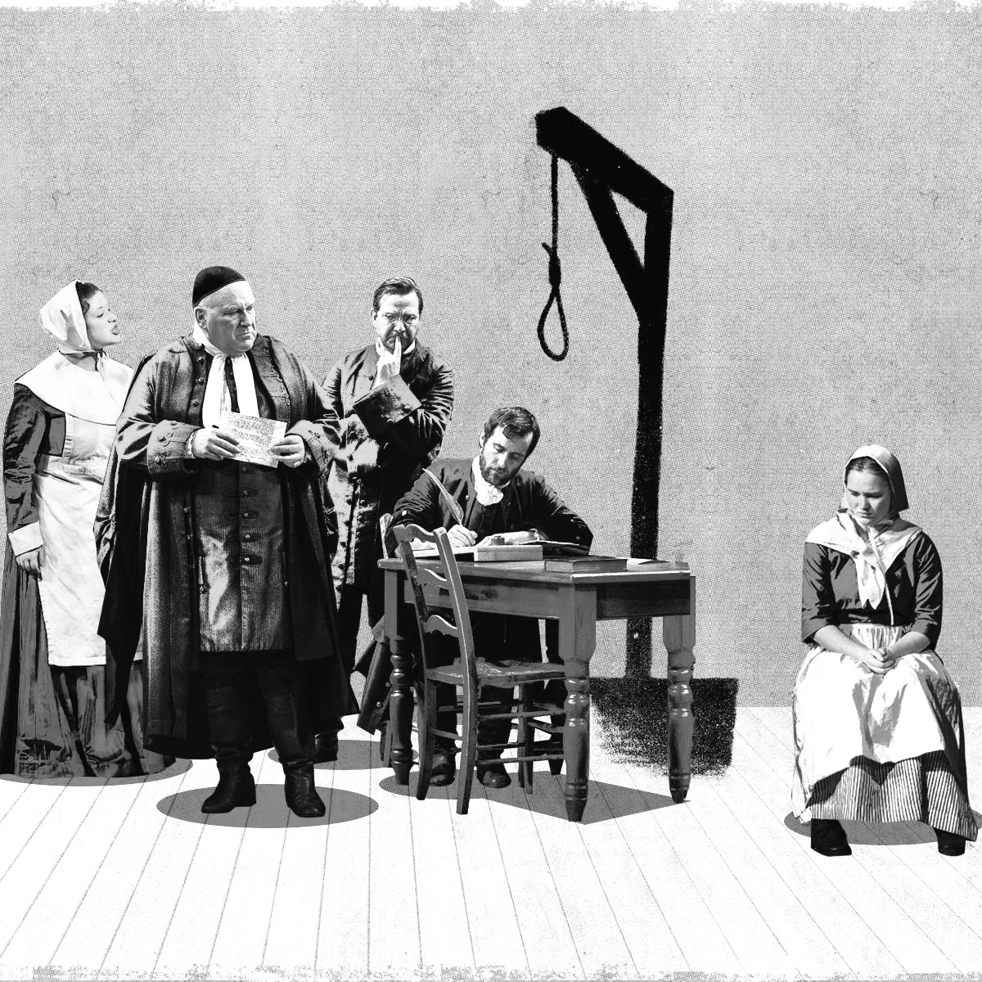



The Crucible
Authorial Choices &
Thematic Motifs

Slide 2
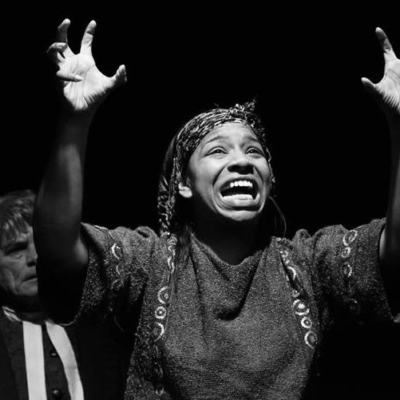
Notable Features / Authorial Choices
Allegory: American political climate of the 1950s
Ironic contrasts: expectation vs. reality
Dramatic irony: audience knows truth
[1] [2]

Slide 3
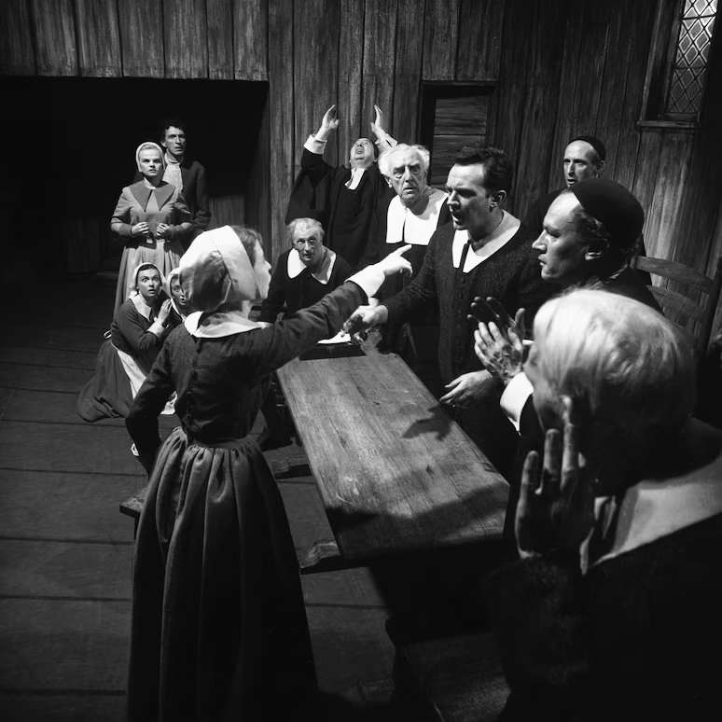
Notable Features / Authorial Choices
Appeals to fear: spectral evidence & Devil threats
Symbolism: confession, heat/cold, hysteria
Biblical allusions & moral authority
[1] [2]

Slide 4

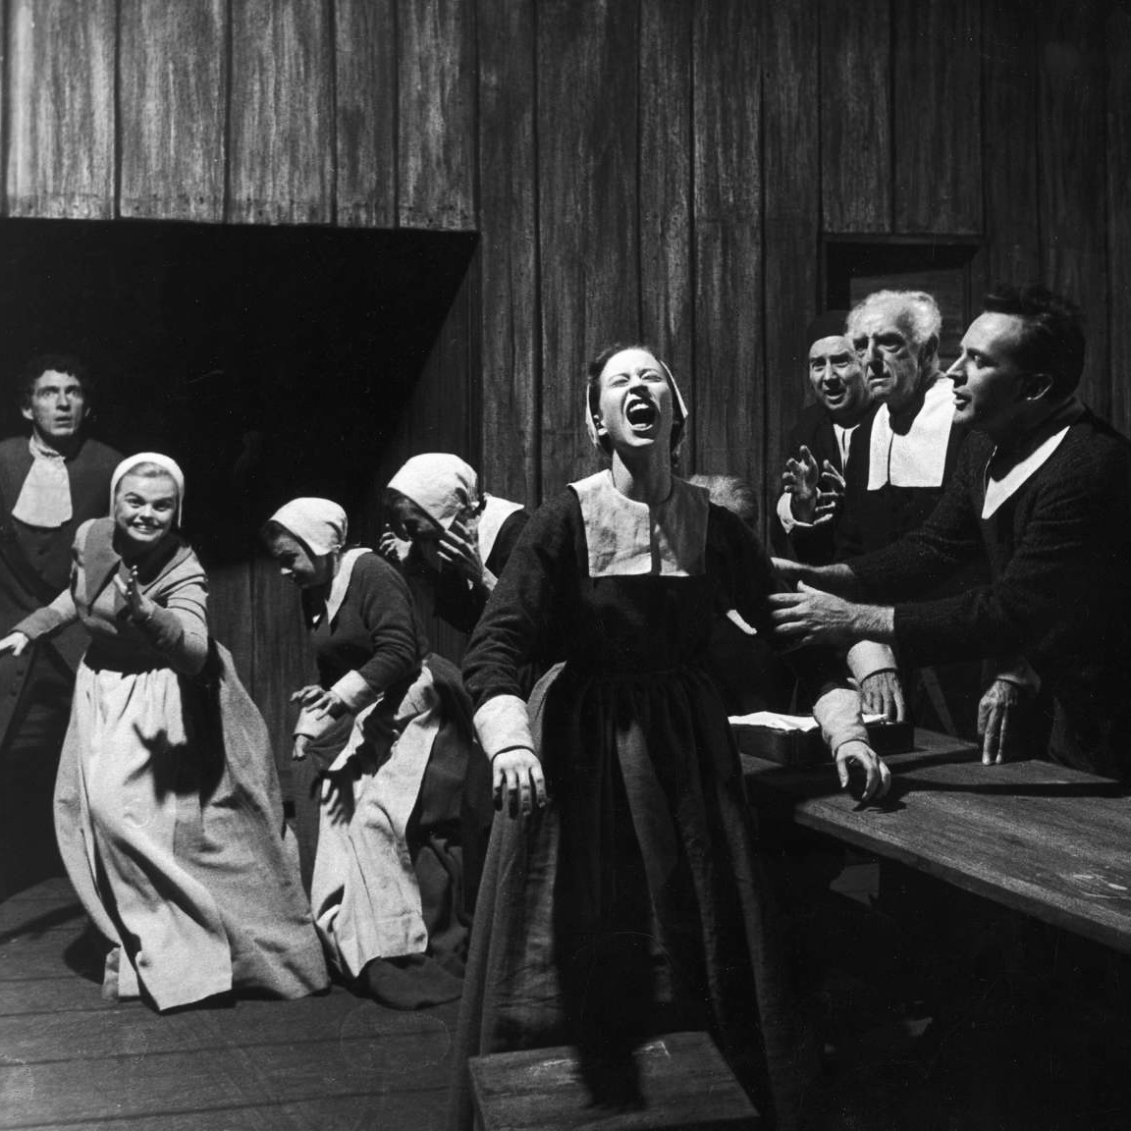
Notable Features / Authorial Choices
Binary language: either with or against
Power shifts: girls gain authority
Scapegoating (blaming others to save oneself)
[3]

Slide 5

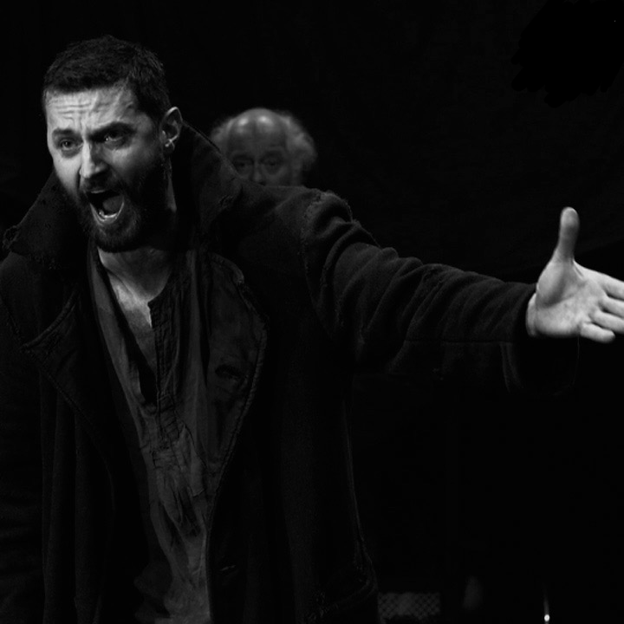
Thematic Motifs
Fear vs. Reason
Reputation vs. Integrity
Conformity vs. Individuality
Empowerment vs. Powerlessness
Judgment & Consequences
[5]

Slide 6








On citation …
Act
[5]

Slide 7

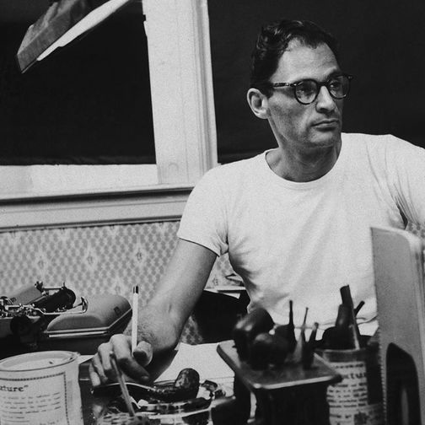
Context vs. Setting
1950s: Red Scare
1953: Miller & McCarthyism
1692: Salem witch trials
history as allegory
[6]

Slide 8

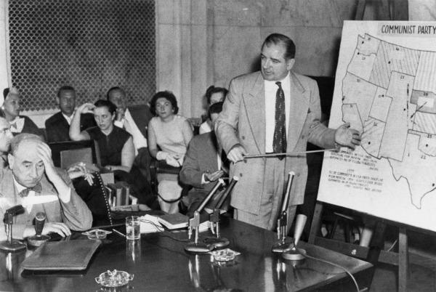
Exigence & Audience
Exigence:
  hysteria & fear controlling America
Audience 1953:
  Americans afraid to speak out
Audience Now:
  times of fear & groupthink
Reminder:
  witch hunts repeat
[7]

Slide 9
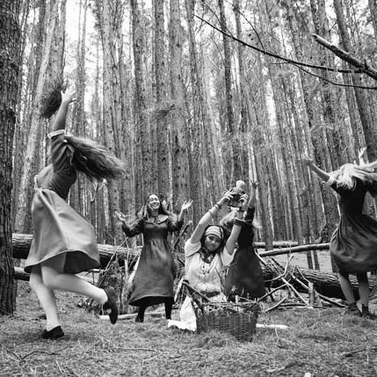
Audience Needs, Values, & Beliefs …
False confessions reinforce the system
Accusations snowball & hysteria spreads
Moral tests: integrity vs. survival
[3]

